Slide 1
NEXATECH
School Operations Platform
School onboarding proposal
A 30 day pilot focused on student records, marks, results, attendance, and controlled school access
Prepared 21 October 2026

Slide 2
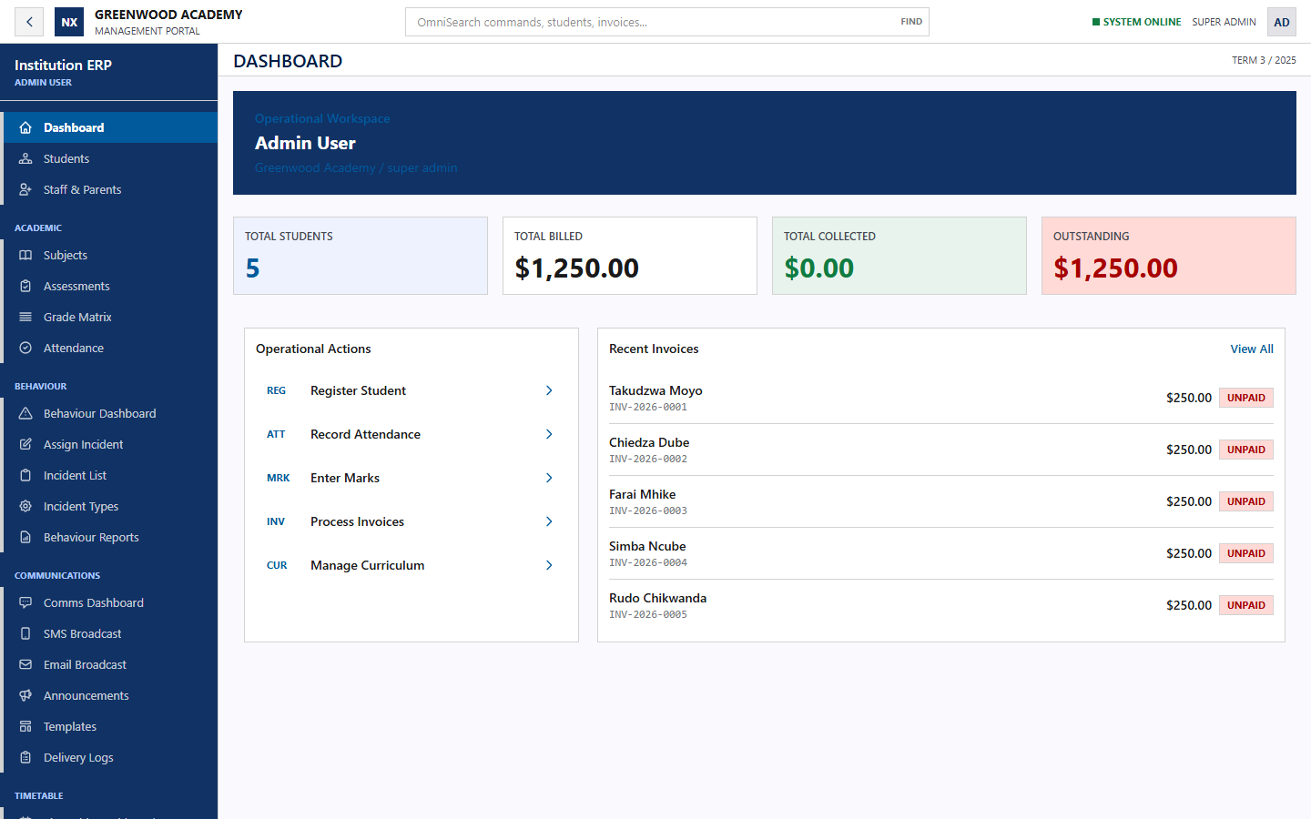
What the system is about
NEXATECH
One connected workspace for routine school operations
Nexatech helps a school capture information once, keep it under controlled access, and retrieve it when staff or families need it.
Faster daily work
Registers, marks, results, invoices, and school records stay in one system.
Clear responsibility
Role based access separates administration, teaching, finance, and parent views.
Reliable records
Validation, audit history, backups, and managed hosting protect the school record.
Synthetic Greenwood Academy demonstration data
02

Slide 3
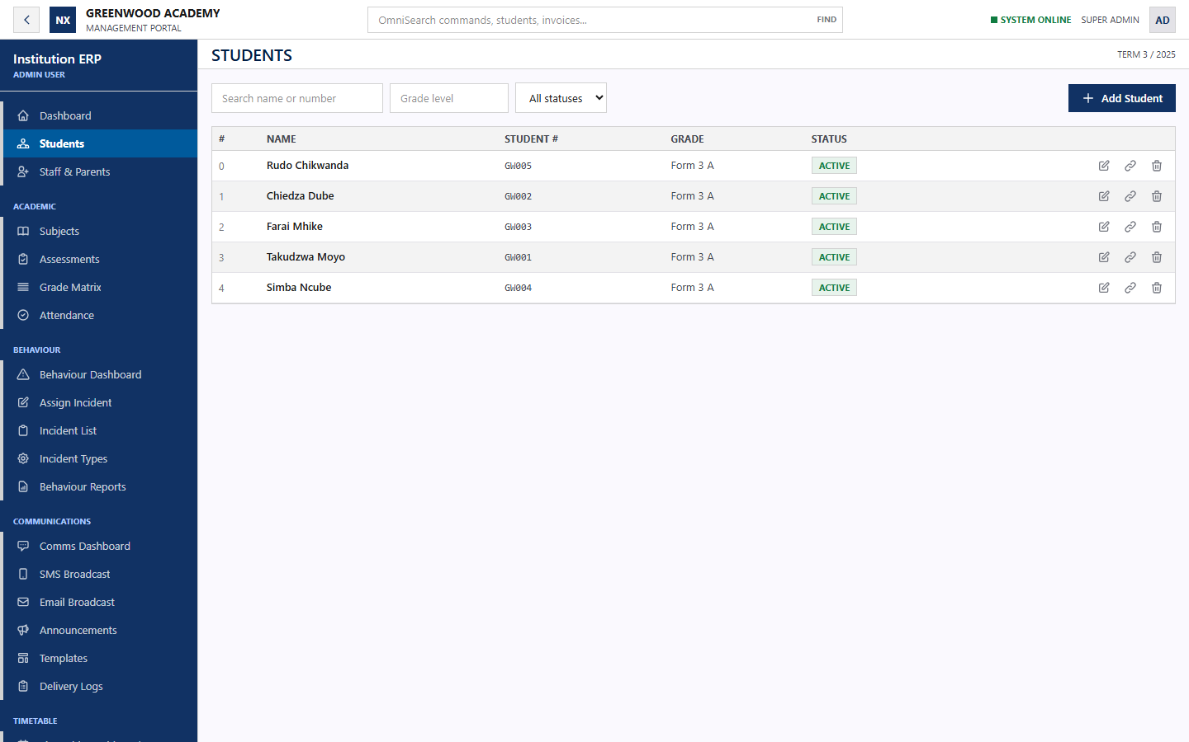
Operational coverage
NEXATECH
The school can begin with academics and extend into the wider platform
Student administration
Searchable learner records, class placement, guardians, and account status.
Academic work
Assessments, grading, marks entry, rankings, report cards, and exports.
School operations
Attendance, finance, timetables, communications, behaviour, and parent access.
Controlled access
Each user sees the records and actions assigned to their role.
03

Slide 4
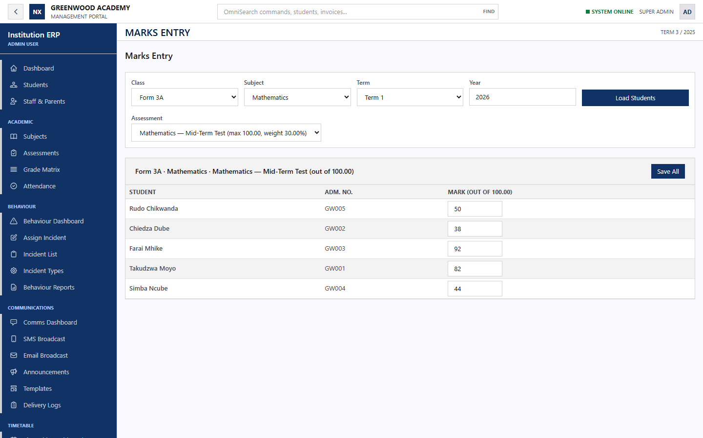
Fast Marks workflow
NEXATECH
The first flagship workflow for the school pilot
Teacher workflow
1 Select the class, subject, term, and assessment
2 Load the correct class roster
3 Enter or update marks in one grid
4 Save the set and retrieve results immediately
Pilot measure
A teacher should complete a 40 learner assessment in under five minutes.
04

Slide 5
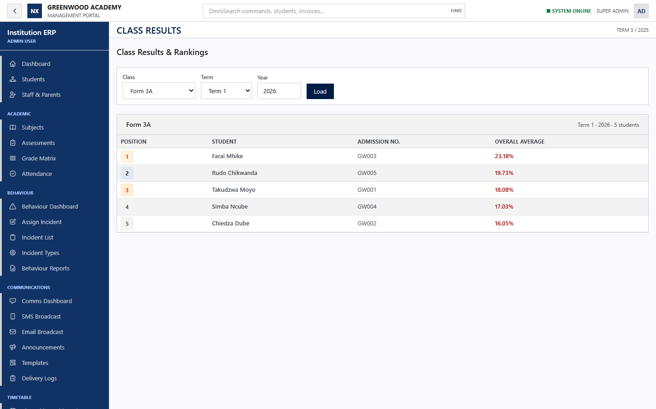
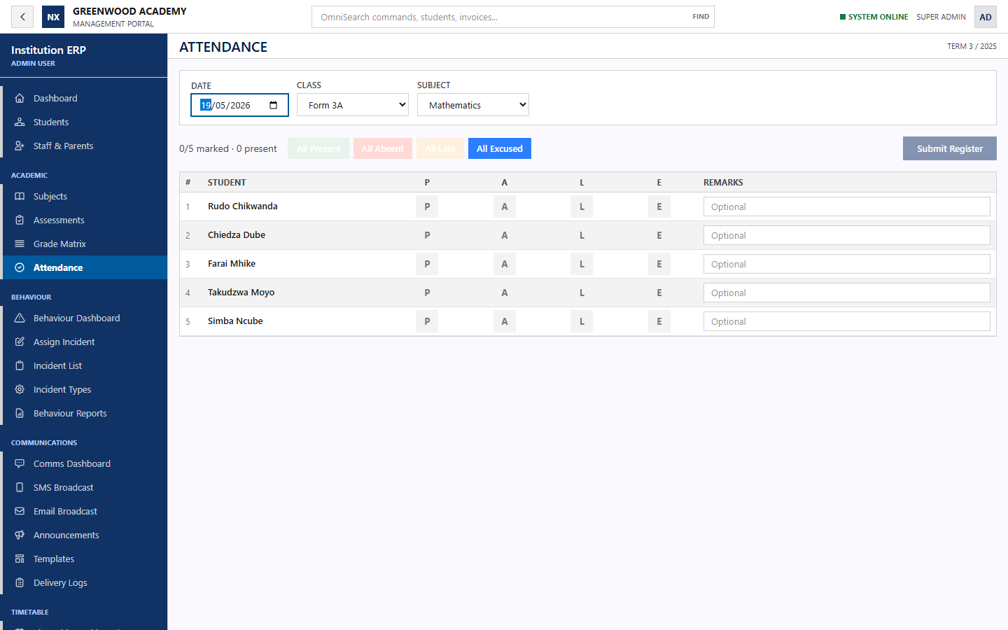
Results and attendance
NEXATECH
The stored record becomes immediately useful to staff
Class results
Attendance register
Authorized staff can retrieve rankings and averages by class, term, and year.
Teachers can open the correct roster and record status with optional remarks.
05

Slide 6
Proposed 30 day pilot
NEXATECH
A controlled evaluation using agreed data and named users
Week 1
Prepare
Confirm scope, clean one data file, configure users and academic settings.
Week 2
Train
Train the administrator and teachers on the agreed workflows.
Week 3
Use
Run student records, marks, results, and attendance with support.
Week 4
Review
Measure time saved, corrections, adoption, and the next rollout decision.
Pilot boundary
Up to 500 active learners, one administrator, up to 10 teachers, and synthetic or school approved data only.
06

Slide 7
Recommended pilot budget
NEXATECH
Starting proposal in US dollars
Item | Included | Price
30 day pilot | Configuration, one clean import, administrator and teacher training, hosting, database, backups, and support | US$299 once
Academic plan | Up to 500 learners, student records, Fast Marks, assessments, results, report cards, attendance, and exports | US$179 / month
Operations plan | Academic plan plus finance, timetable, communications, behaviour, parent portal, and priority support | US$299 / month
Public API access | One documented integration, scoped credentials, logs, standard rate limit, and key rotation support | US$49 / month
Dedicated database | Dedicated managed database resources where the school requires separation beyond the standard tenant design | From US$75 / month
Pilot fee credit
If the school signs the Academic or Operations plan within 14 days of the pilot review, apply the US$299 pilot fee toward the standard US$350 onboarding charge.
SMS, email, payment provider fees, complex historical data cleaning, taxes, and custom integrations remain separate.
07

Slide 8
Technical foundation
Current implementation and hosting model
Application
Data and operations
React 19, Vite 8, Tailwind CSS 4, Axios, Laravel 13, PHP 8.4, Sanctum, DOMPDF, and Paynow SDK
Managed MySQL, Redis queues and cache, encrypted sessions, backups, scheduler, worker, logs, and health checks
Hosting
Next step
Docker deployment on Railway with separate web, worker, scheduler, MySQL, and Redis services behind HTTPS
Agree the pilot scope, nominate the school lead, approve the data set, and schedule the demonstration.
Nexatech School Operations Platform
08

